Slide 1
VIS —Pathfinding Algorithms
Ruihao Li
Yixun Wei

Slide 2
Algorithms
A*
Best-First
Dijkstra
BFS

Slide 3
Brief Introduction
Breadth First Search explores equally in all directions. This is an incredibly useful algorithm, not only for regular path finding, but also for procedural map generation, flow field pathfinding, distance maps, and other types of map analysis.

Slide 4
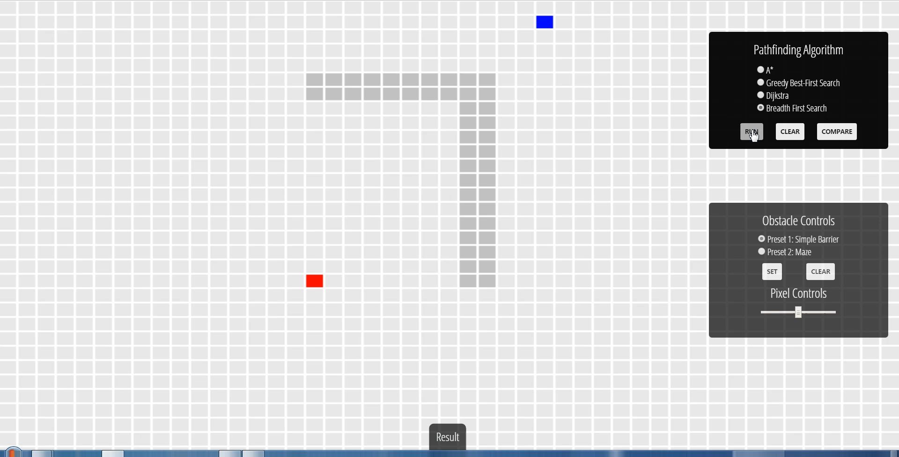
BFS Algorithm

Slide 5
Brief Introduction
Dijkstra’s Algorithm (also called Uniform Cost Search) lets us prioritize which paths to explore. Instead of exploring all possible paths equally, it favors lower cost paths. We can assign lower costs to encourage moving on roads, higher costs to avoid forests, higher costs to discourage going near enemies, and more. When movement costs vary, we use this instead of Breadth First Search.

Slide 6
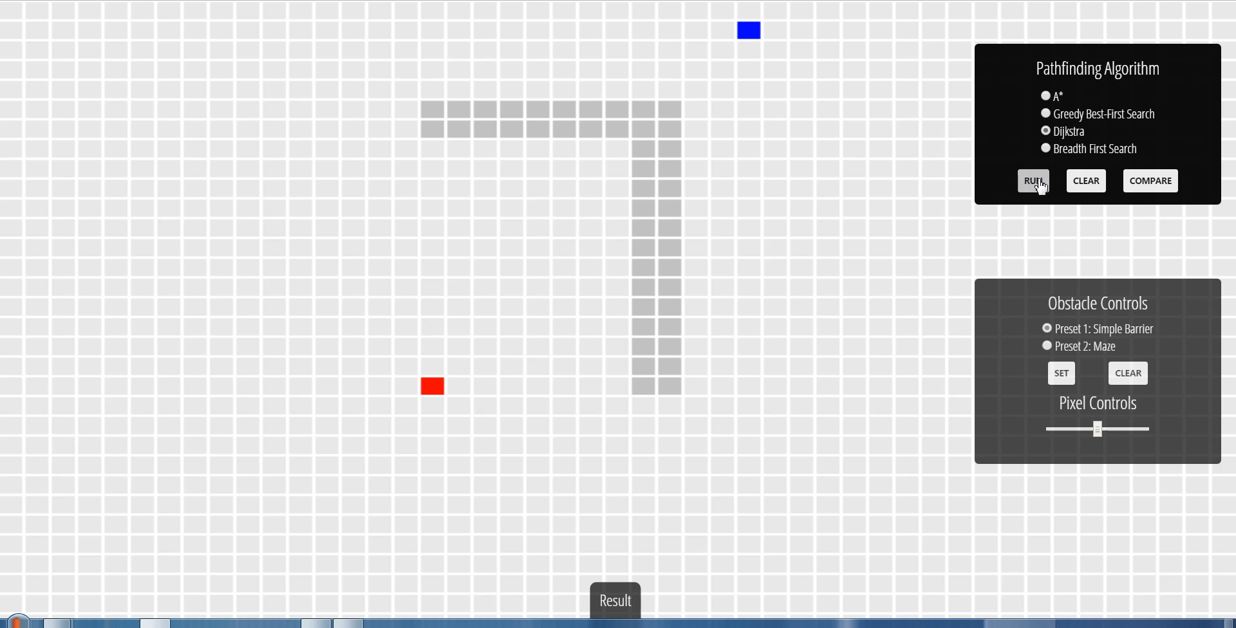
Dijkstra Algorithm

Slide 7
Brief Introduction
The Greedy Best-First-Search algorithm works in a similar way, except that it has some estimate (called a heuristic) of how far from the goal any vertex is. Instead of selecting the vertex closest to the starting point, it selects the vertex closest to the goal. Greedy Best-First-Search is not guaranteed to find a shortest path. However, it runs much quicker than Dijkstra’s Algorithm because it uses the heuristic function to guide its way towards the goal very quickly.

Slide 8
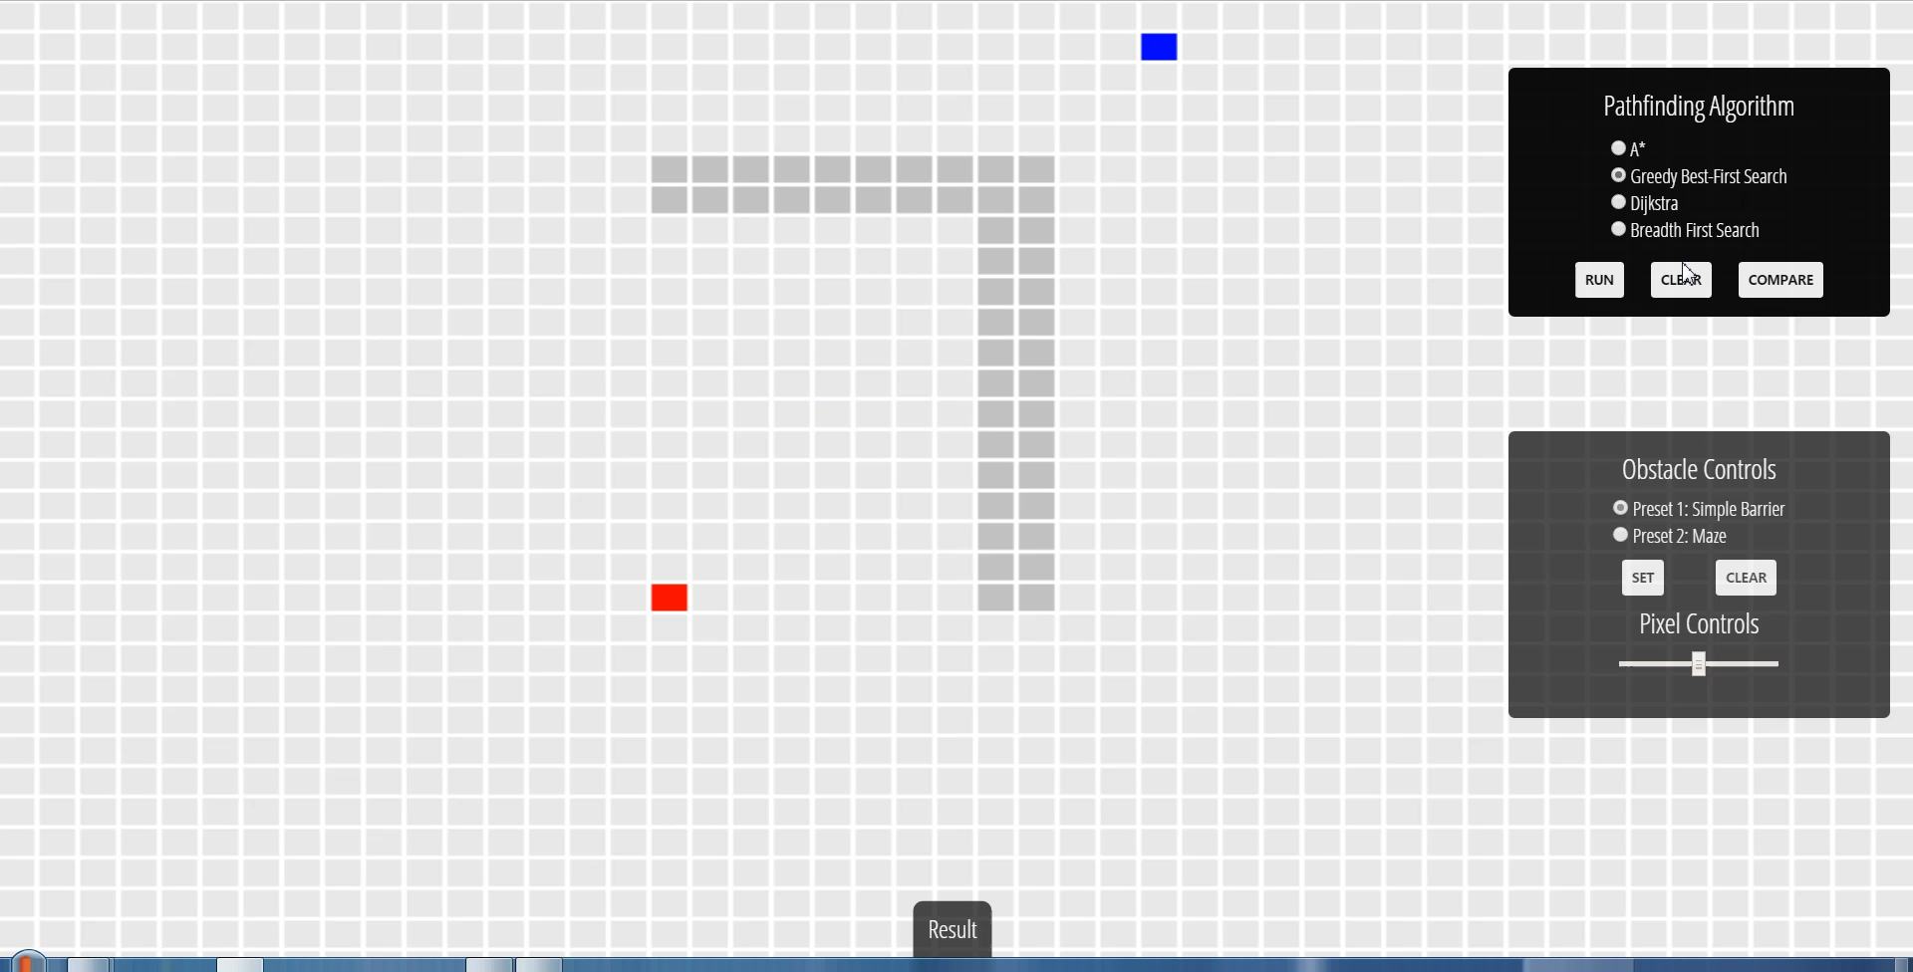
Best-First Algorithm

Slide 9
Brief Introduction
A* is a modification of Dijkstra’s Algorithm that is optimized for a single destination. Dijkstra’s Algorithm can find paths to all locations; A* finds paths to one location. It prioritizes paths that seem to be leading closer to the goal.

Slide 10
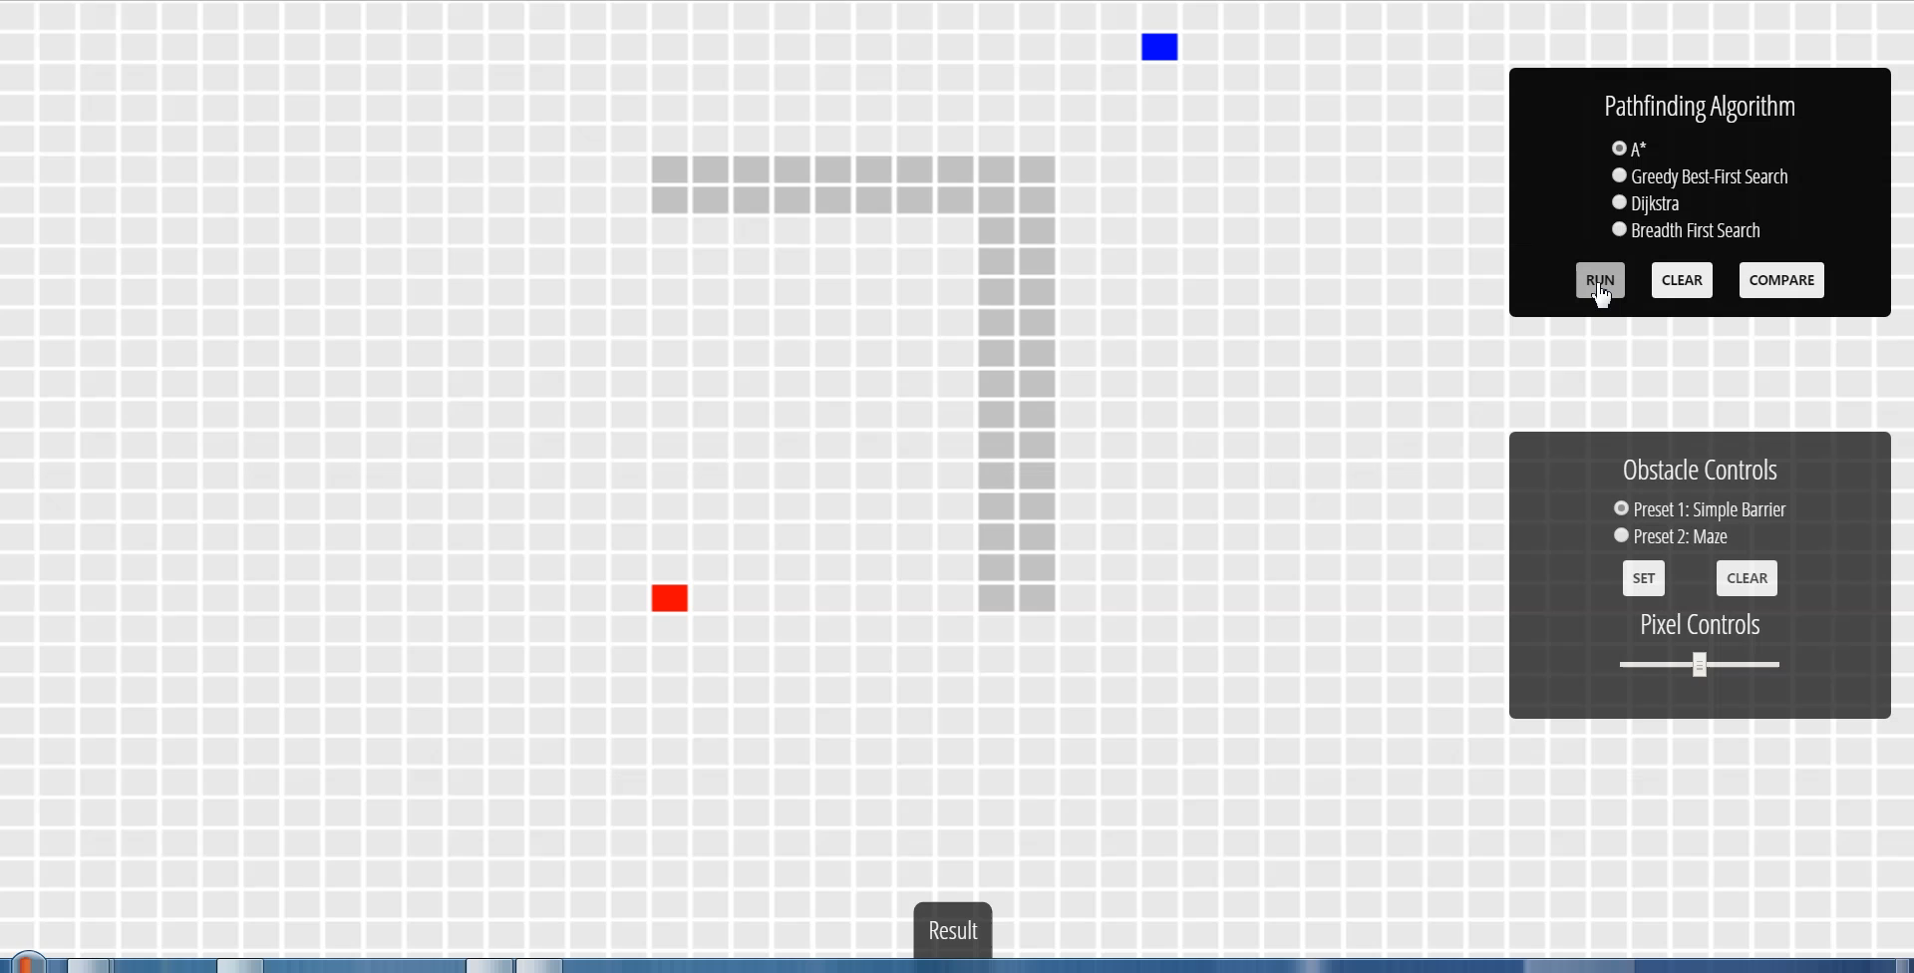
A* Algorithm

Slide 11
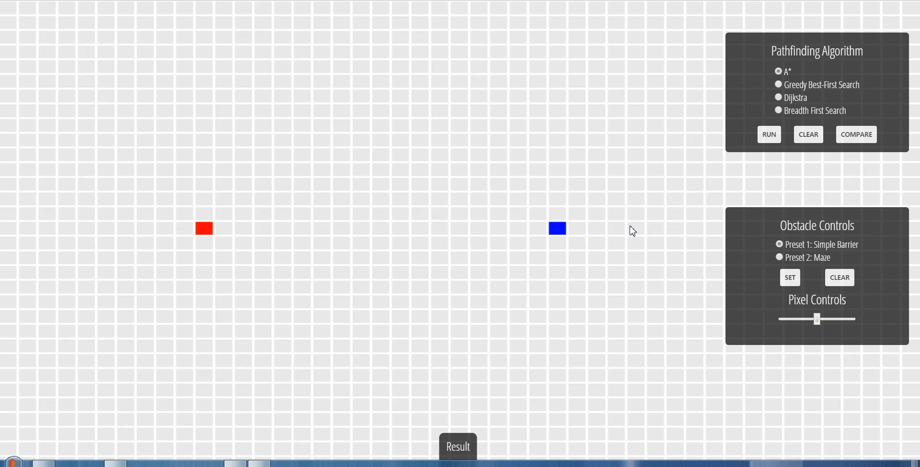
Various Obstacles

Slide 12

Draw obstacles

Slide 13
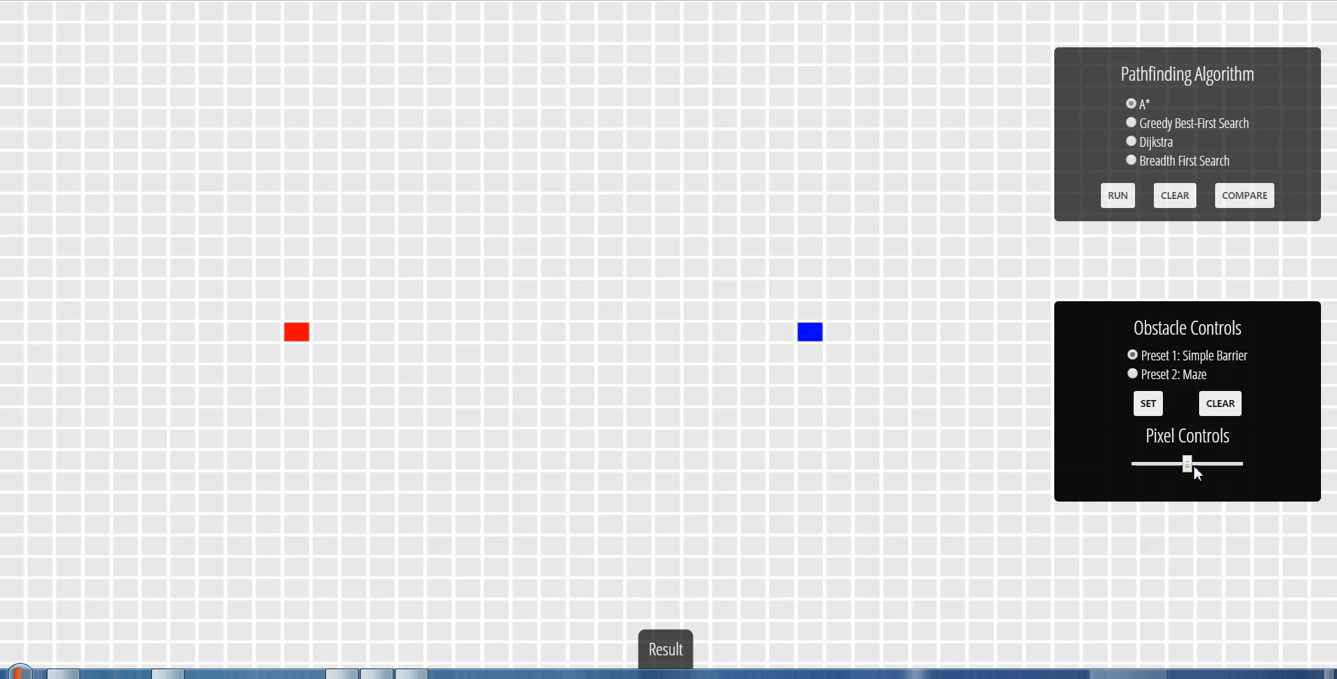
Resize the Canvas

Slide 14
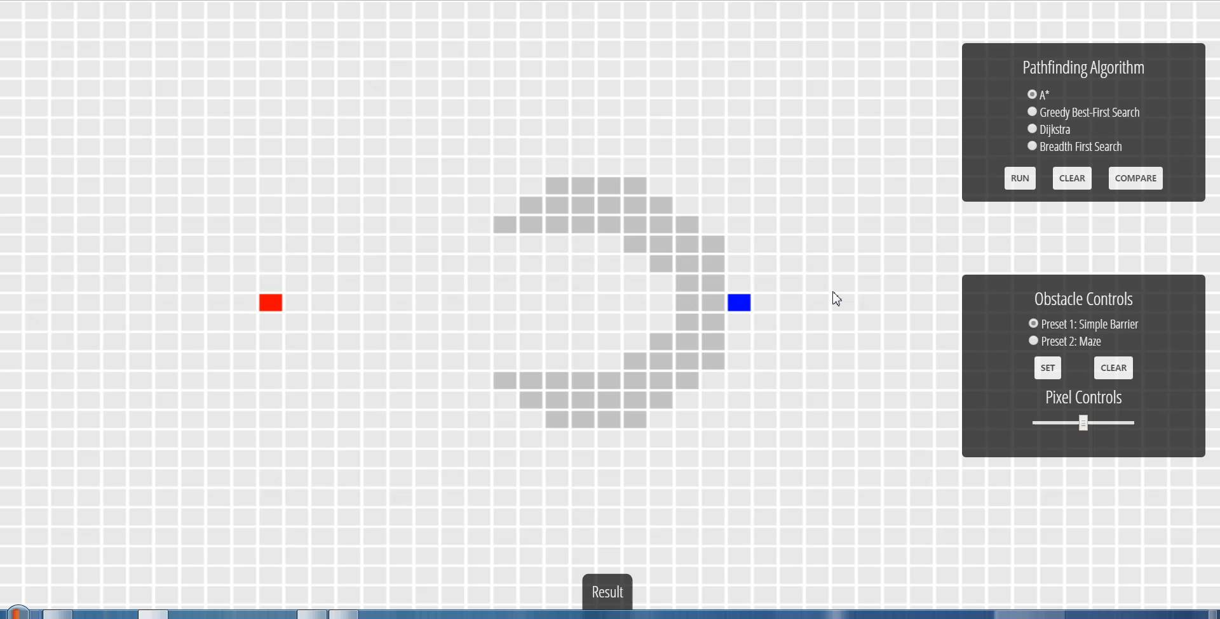
Comparison

Slide 15
Summary
Breadth First Search explores equally in all directions, but it cannot deal with the cost.
Dijkstra’s Algorithm works well to find the shortest path, but it wastes time exploring in directions that aren’t promising.
Greedy Best First Search explores in promising directions but it may not find the shortest path.
The A* algorithm uses both the actual distance from the start and the estimated distance to the goal.

Slide 16
Thank You

